Slide 1
Group 1
PROJECT PROPOSAL
106-1 12/14 Software Engineering Design

Slide 2
Homework

Slide 3
Requirements Statement
A reader for the RTF (Rich Text Format) document exchange format should be able to convert RTF to many text formats.
The reader converts RTF documents into TeX text or into a text widget by recognizing different RTF tokens (Character, Font Change and Paragraph).

Slide 4
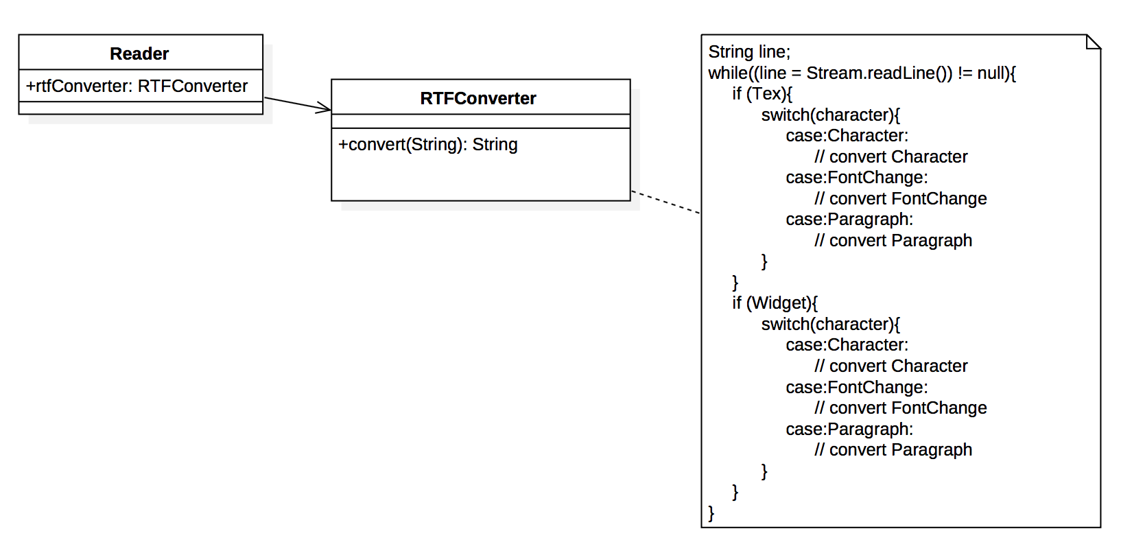
HW1: Initial Design

Slide 5
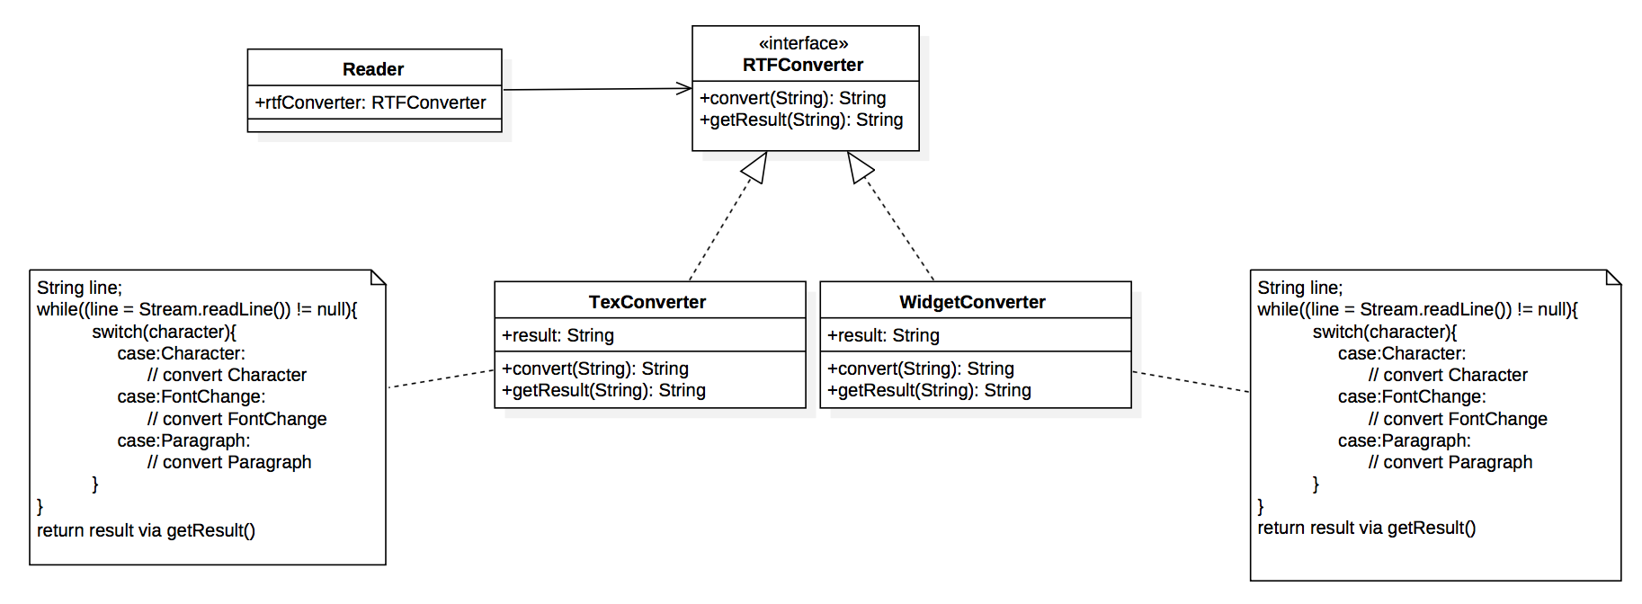
HW1: Refactored

Slide 6
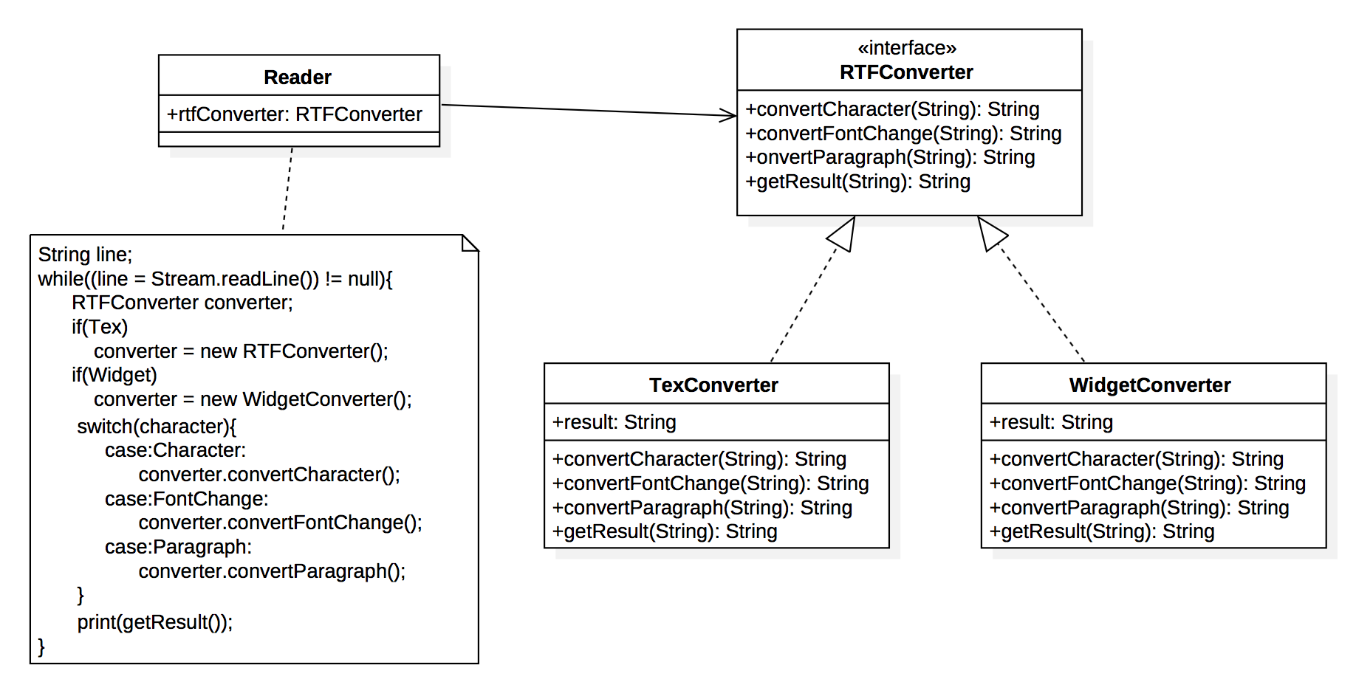
HW1: Final Design

Slide 7
Requirements Statement
A chocolate boiler is used to boil chocolate. Before boiling chocolate with the boiler, you have to make sure that the boiler is now empty and then fill chocolate in.
Besides, you can’t boil chocolate again while the chocolate has already been boiled.
After boiling, drain out the boiled chocolate and make the boiler empty again.
In order to prevent some unexpected situation, it is not allowed to have multiple instances of the chocolate boiler in the system.

Slide 8
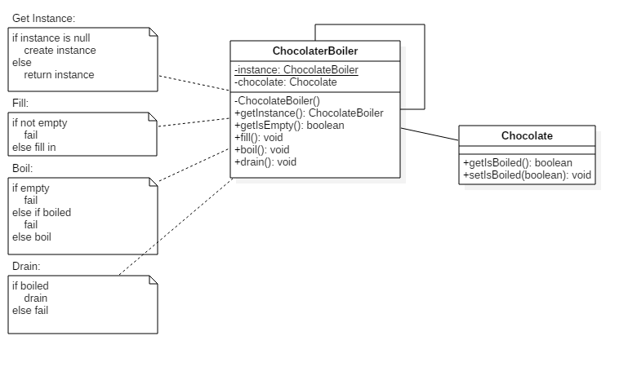
HW2:

Slide 9
Open Source Work-Through
Graph
Event
Multiset

Slide 10
Graph
Graph
Event
Multiset
Iterator Pattern & Graph

Slide 11
Iterator Pattern
Intent:
Provide a way to access the elements of an aggregate object sequentially without exposing its underlying representation.
Iterator Pattern Class Diagram

Slide 12
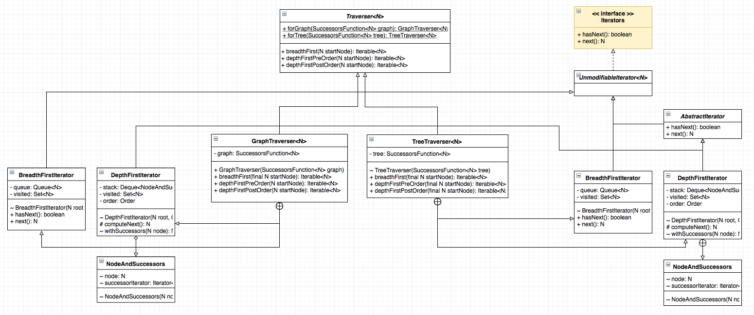
Graph Traverse Iterator
Notes:
Traverser: container
Iterators: Iterator
common.graph does not (at this time) include explicit support for the following graph variants, although they can be modeled using the existing types:
trees, forests
graphs with elements of the same kind (nodes or edges) that have different types (for example: bipartite/k-partite graphs, multimodal graphs)
hypergraphs
common.graph does not allow graphs with both directed and undirected edges.

Slide 13
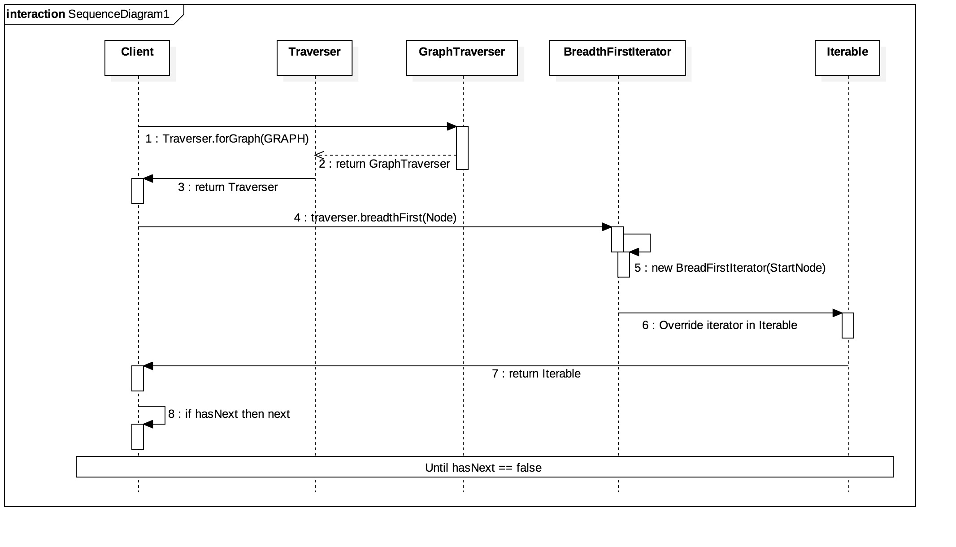
Traverser Sequence Diagram - BreadFrist

Slide 14
Event
Graph
Event
Set
Multiset
EventBus, Optional, and Supplier

Slide 15
EventBus

Slide 16
Observable (Event)
public class Event {
private String message;
public Event(String message) {
this.message = message;
}
public String getMessage() {
return message;
}

Slide 17
Observer (Listener)
public class EventListener {
public String lastMessage;
@Subscribe
public void listen(TestEvent event) {
this.lastMessage = event.getMessage();
System.out.println(“Message” + lastMessage);

Slide 18
Simple Example
{
EventBus eventBus = new EventBus();
EventListener listener = new EventListener();
eventBus.register(listener);
eventBus.post(new TestEvent(200));
eventBus.post(new TestEvent(300));
eventBus.post(new TestEvent(400));
}

Slide 19
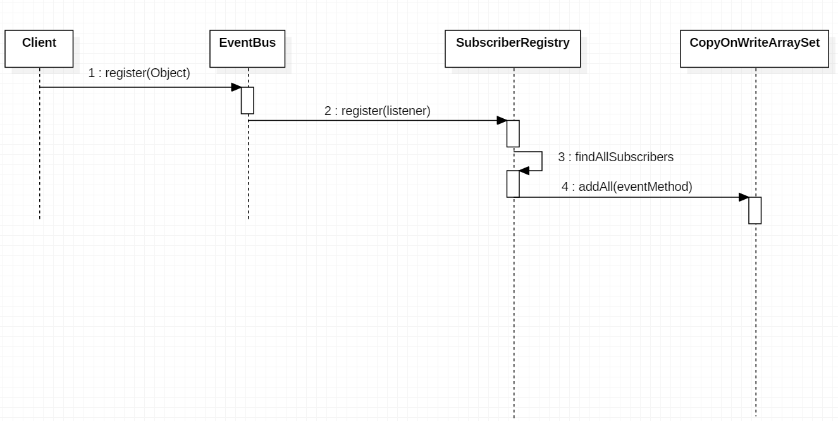
Register Sequence Diagram
Register

Slide 20
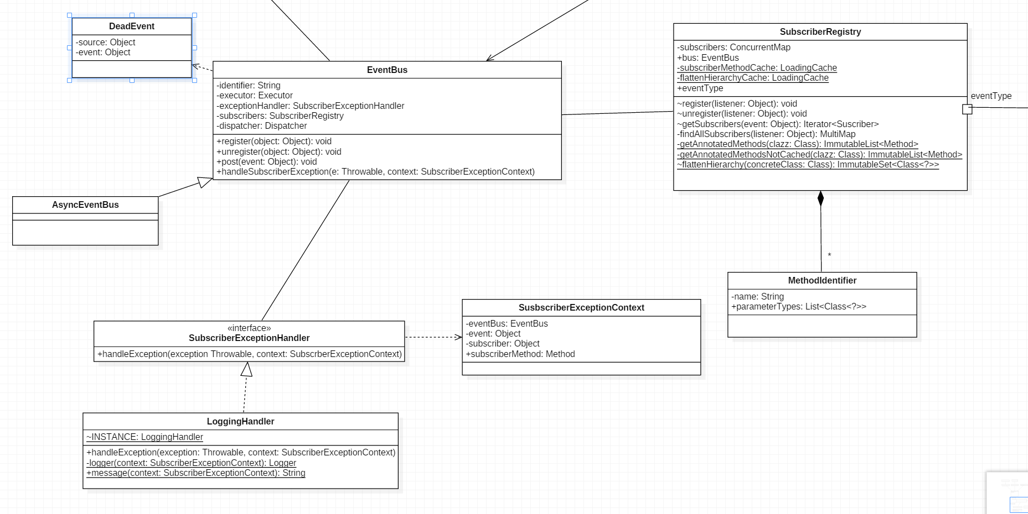

Slide 21
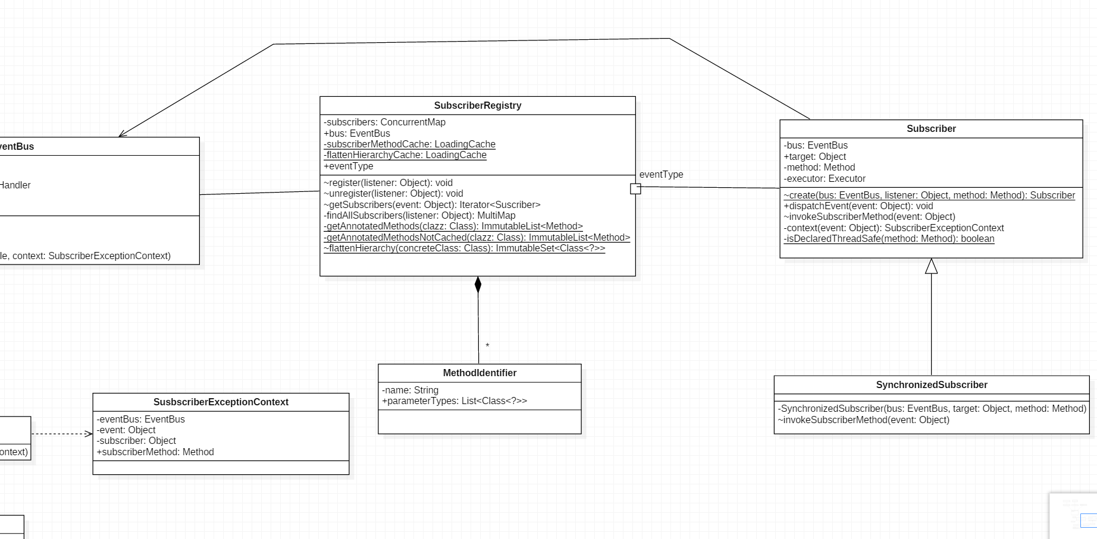

Slide 22
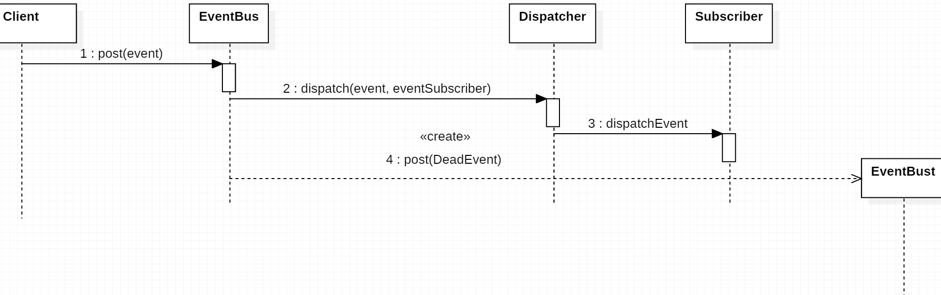
Post Sequence Diagram

Slide 23
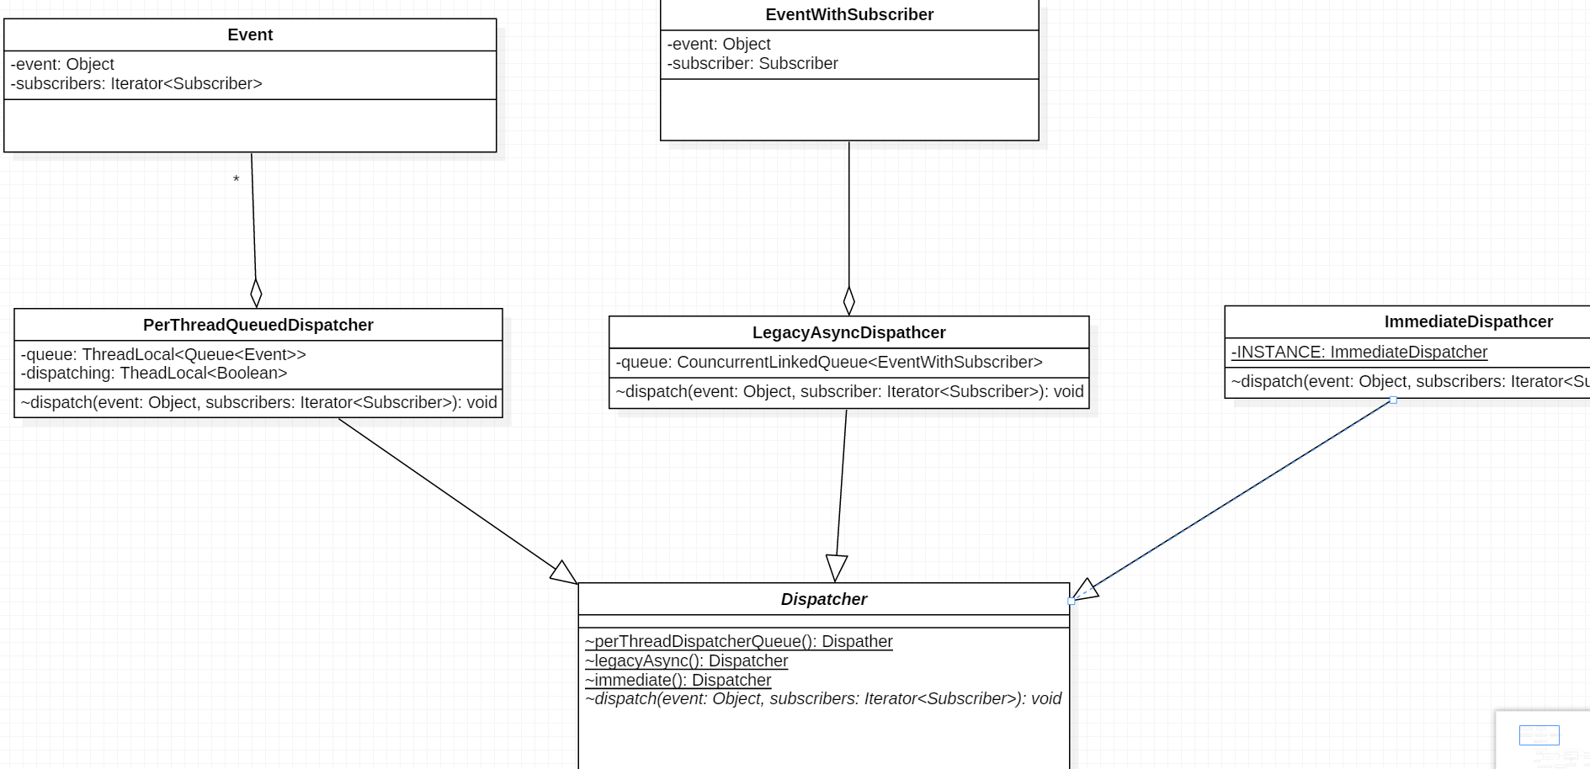

Slide 24
Optional

Slide 25
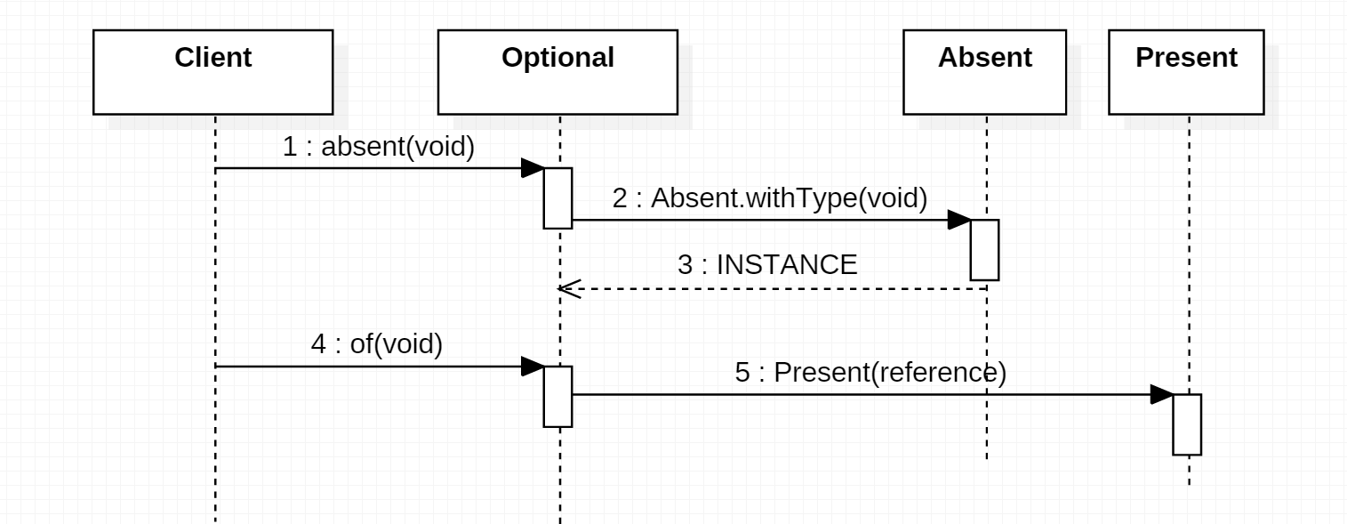
Sequence Diagram

Slide 26
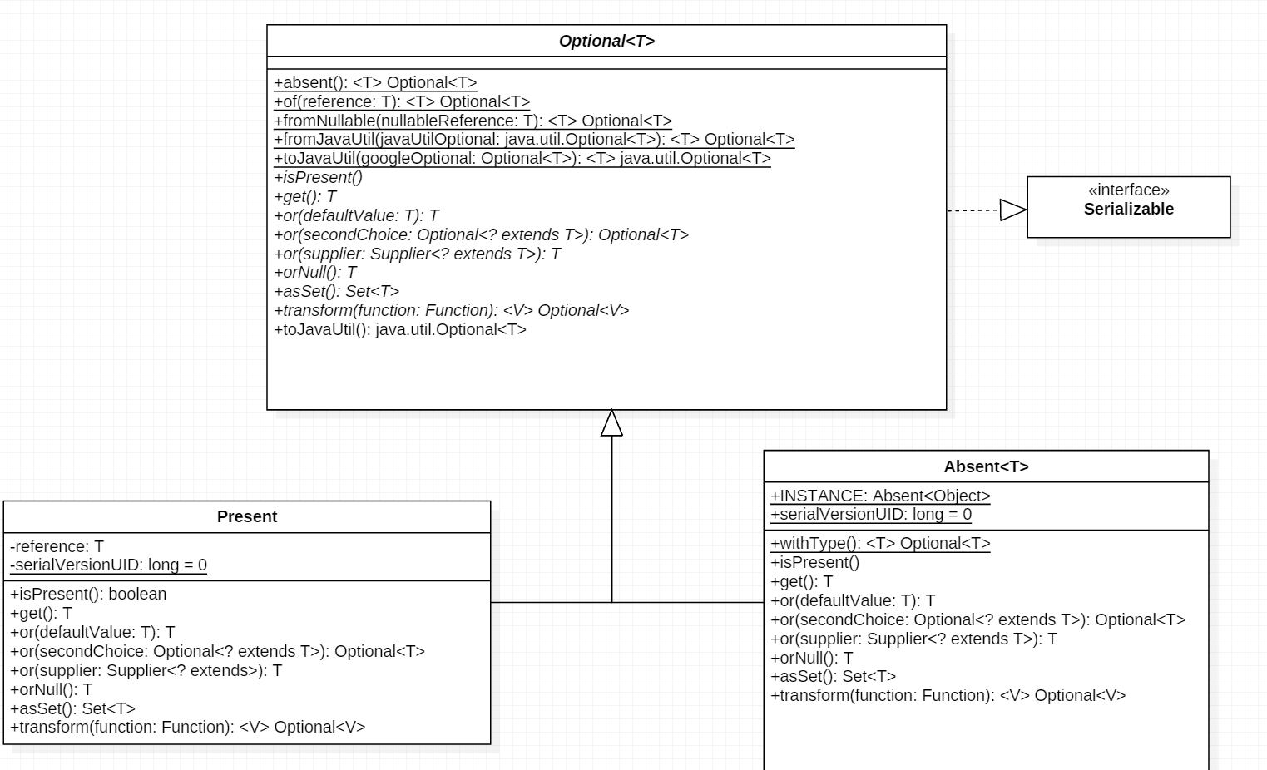
Function

Slide 27
Supplier

Slide 28
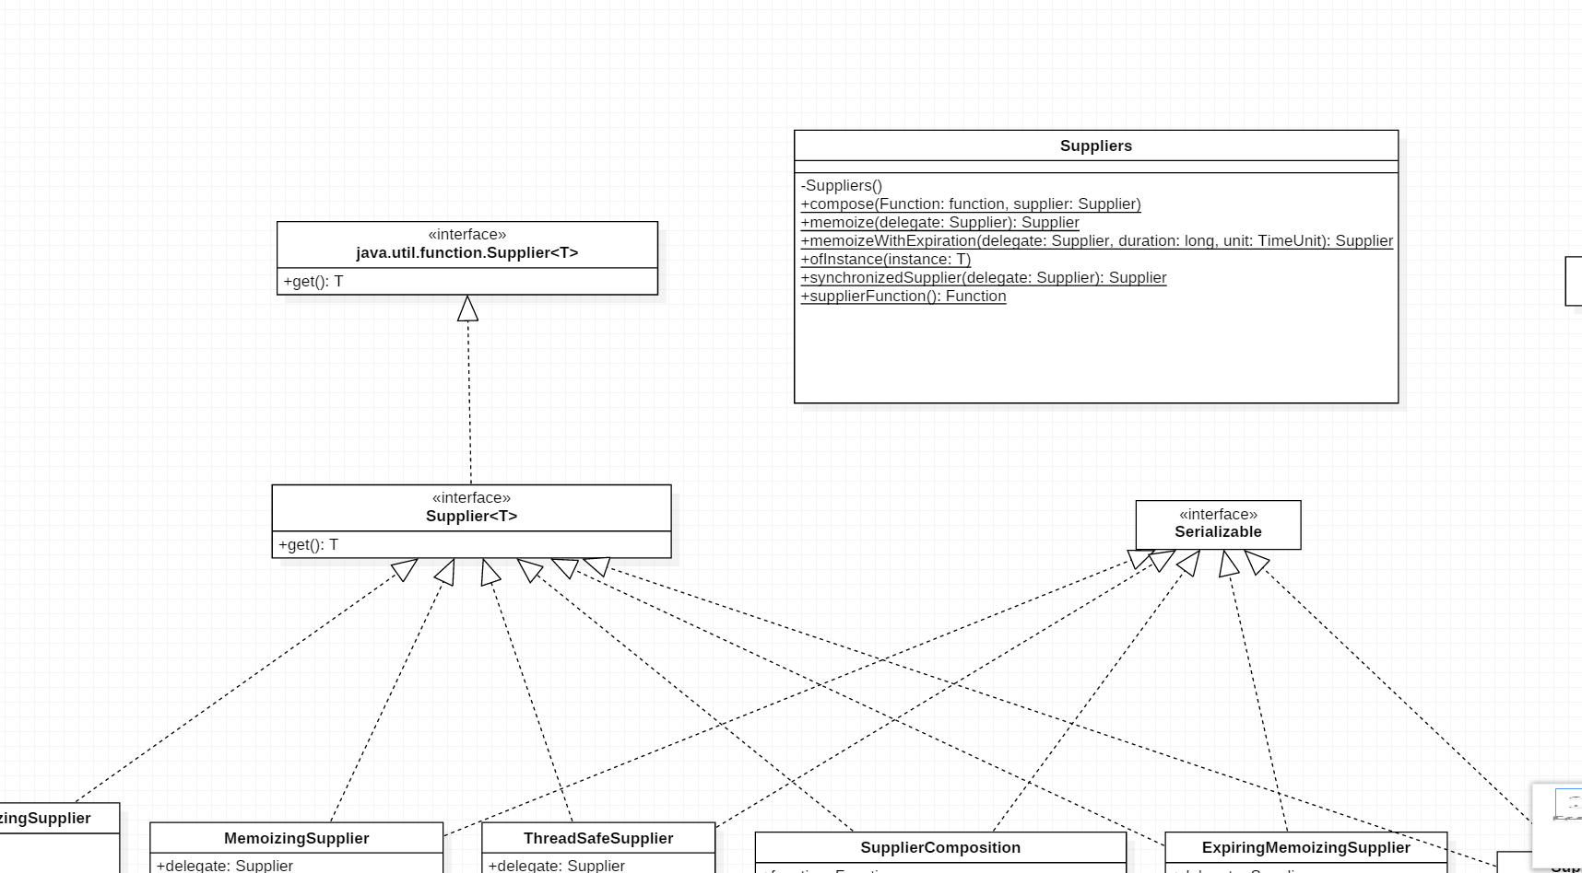
Supplier

Slide 29
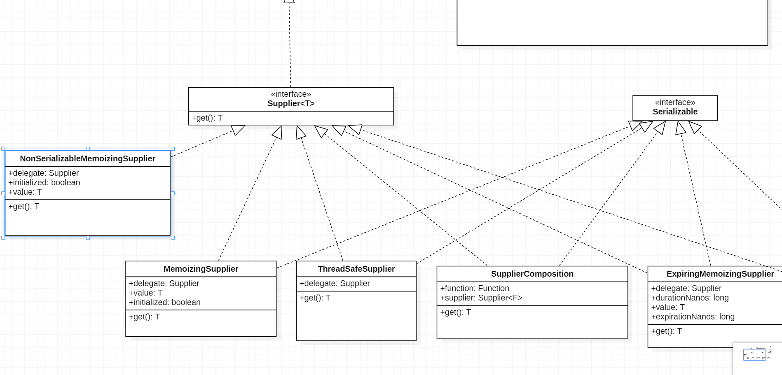
Supplier

Slide 30
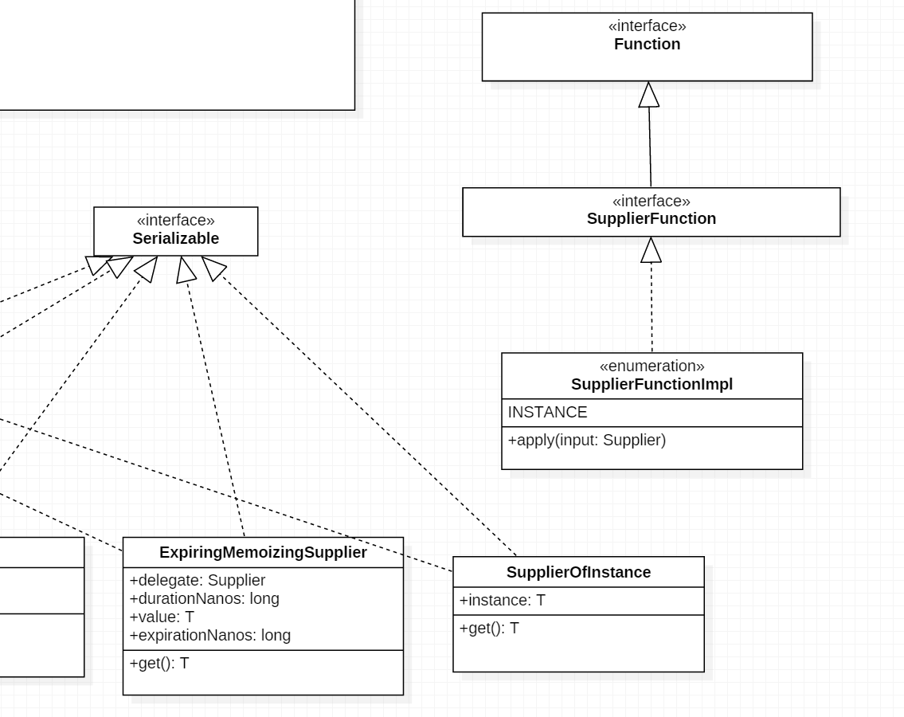
Supplier

Slide 31
Multiset
Graph
Event
Multiset
AbstractMultiset, ForwardingMultiset, and SortedMultiset

Slide 32
Preview: Collection Framework in Java
Collection | Duplicated? | Ordered? | Positional Access?
List | Y | Y | Y
Set | N | depends | N
Map | Key: N Value: Y
http://www.kriblog.com/

Slide 33
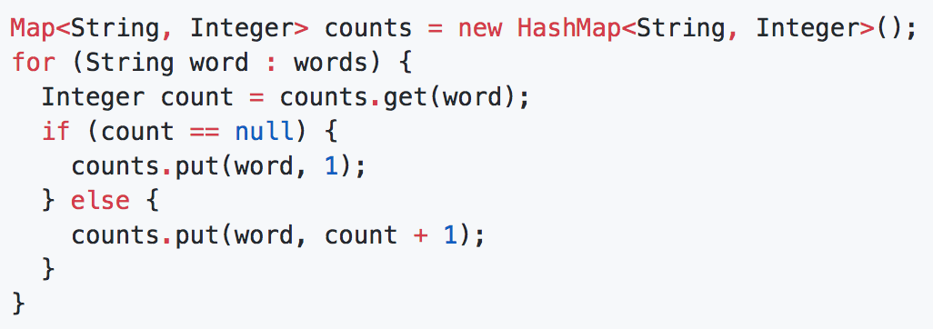
Multiset
Why Multiset:
Features:
Multiset is a true Collection type
Multiset is like an ArrayList<E> without an ordering constraint
Multiset<E> is not a Map<E, Integer> , but it’s like a Map<E, Integer>, with elements and counts

Slide 34
Preview: Set hierarchy in java
/** Copyright (c), AnkitMittal
JavaMadeSoEasy.com */

Slide 35
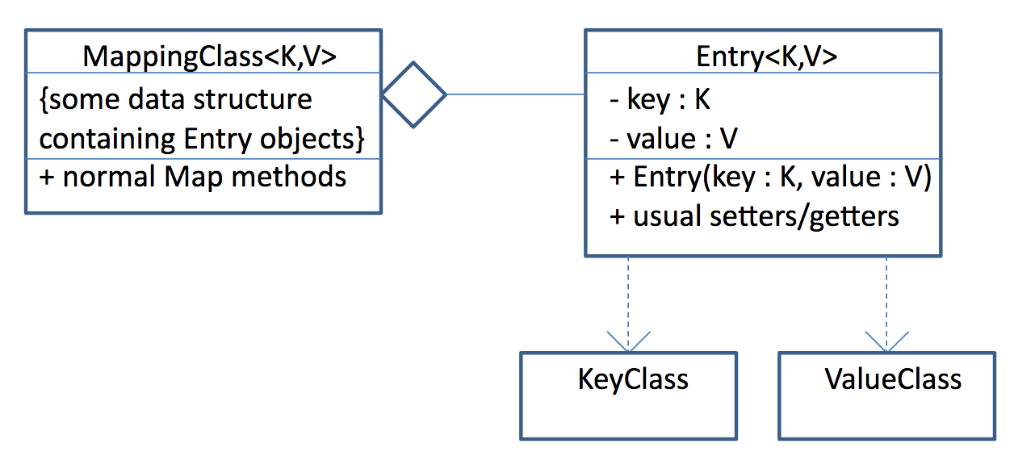
Preview: Map framework in java
https://read01.com/Po8Eok.html

Slide 36
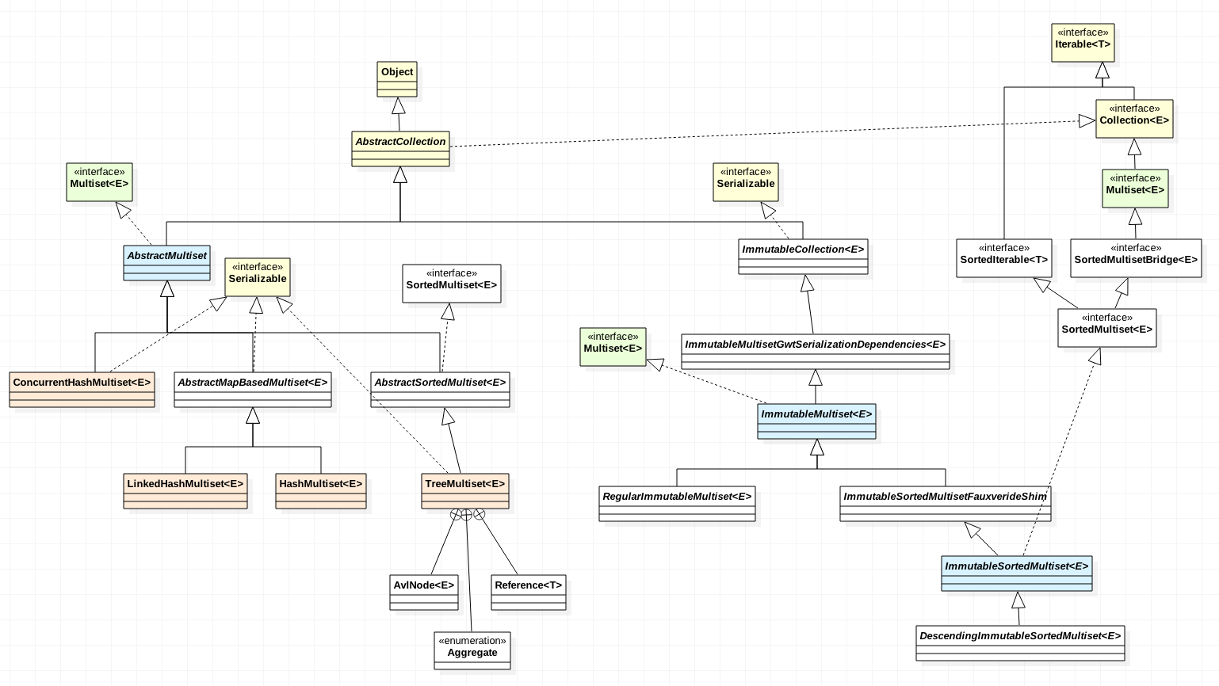
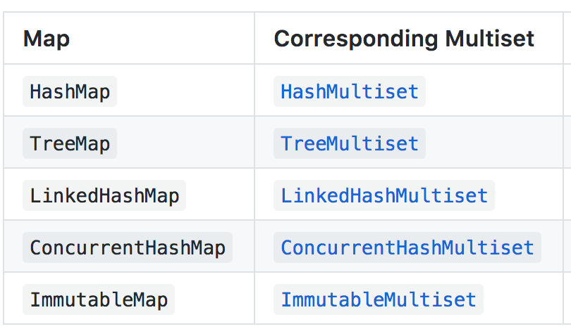
Multiset

Slide 37
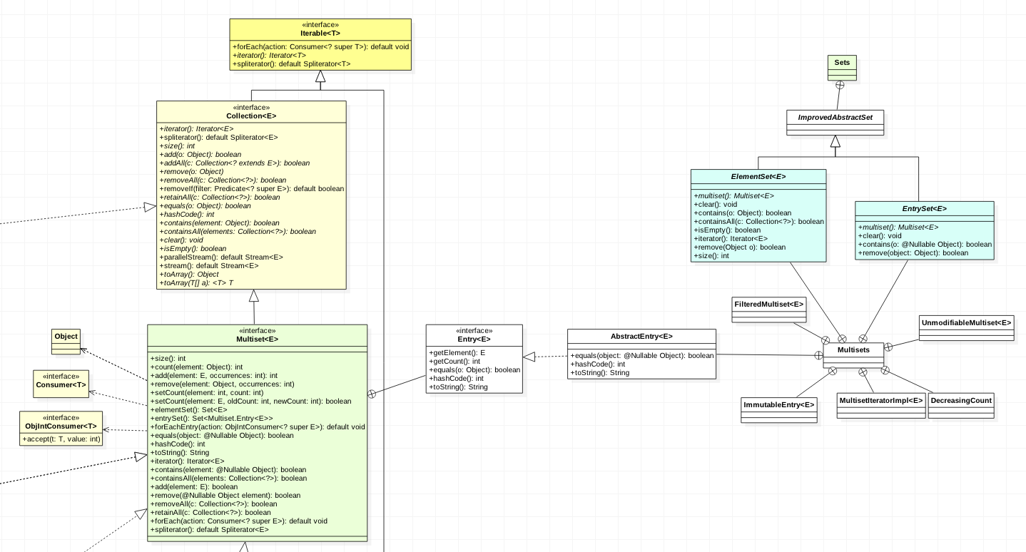
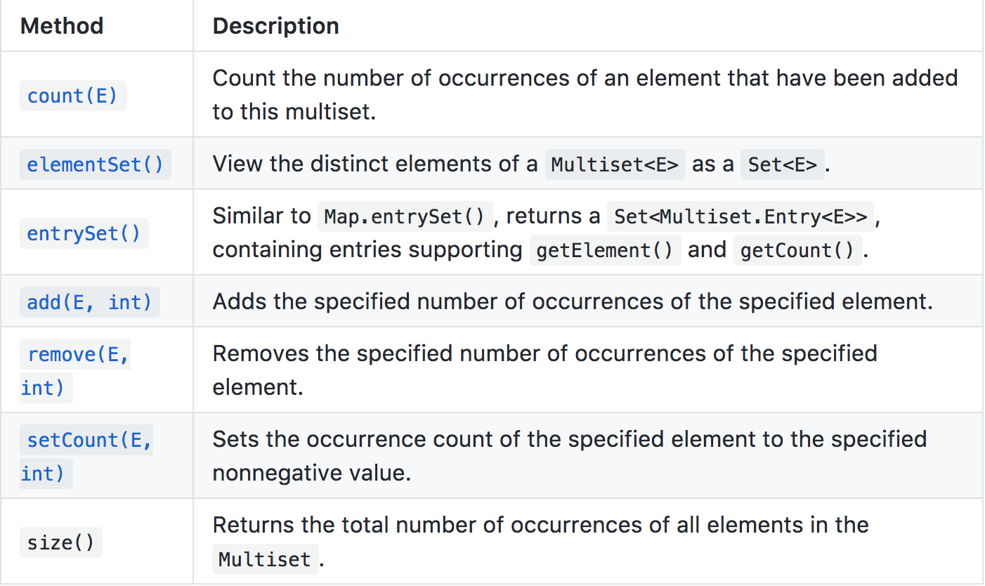
Multiset

Slide 38
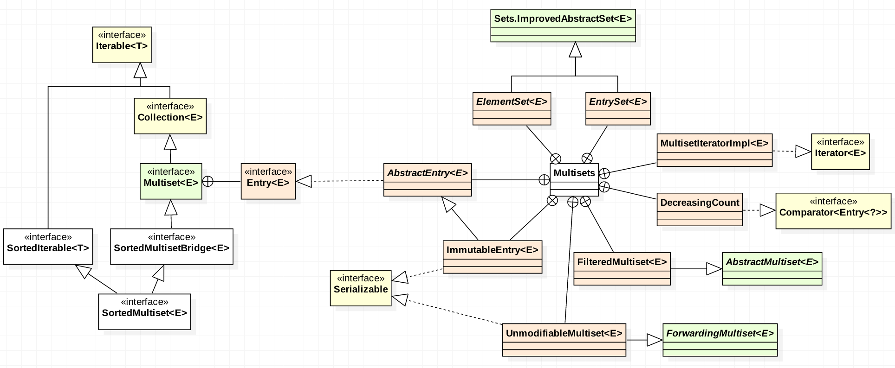
Multiset—static methods

Slide 39
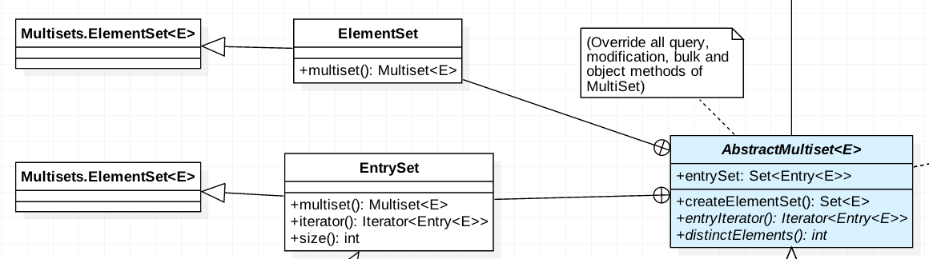
AbstractMultiset

Slide 40
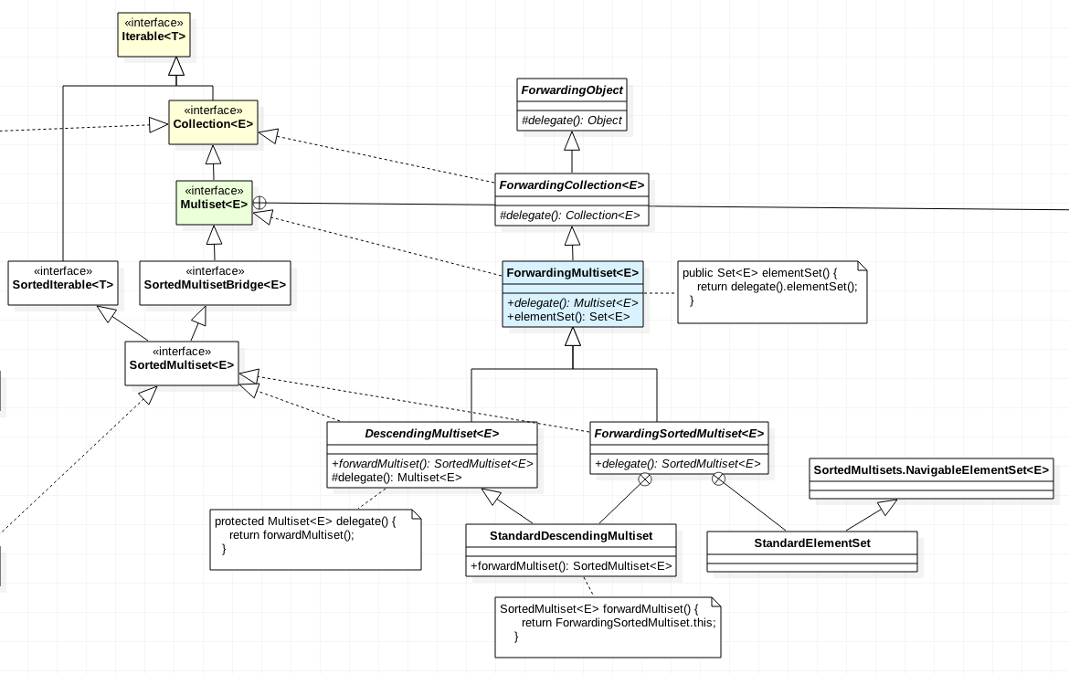
Multiset-Forwarding
In OOP, forwarding means that using a member of an object (either a property or a method) results in actually using the corresponding member of a different object: the use is forwarded to another object.

Slide 41
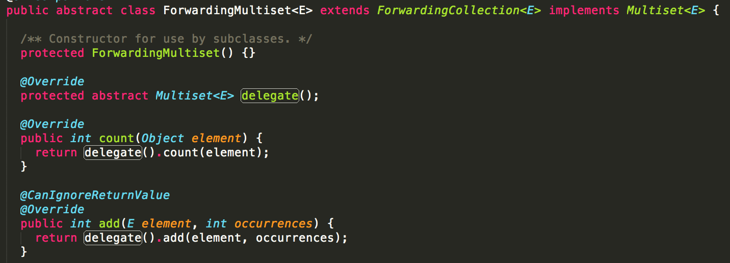
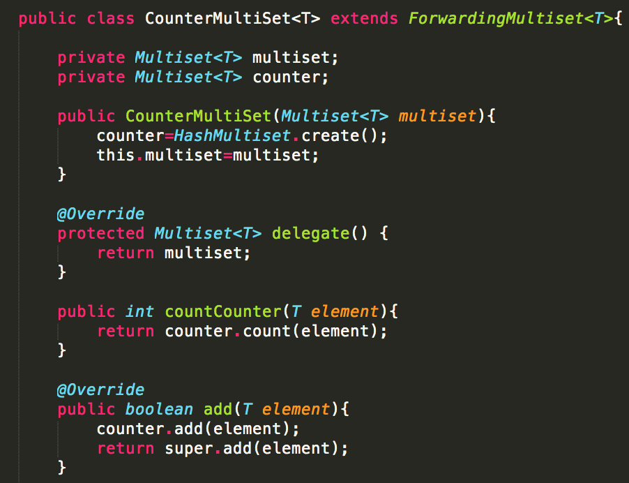
ForwardingMultiset-example

Slide 42
Thanks!
Any questions?

